Slide 1
Trigonometric Ratios and Functions
Algebra 2
Chapter 13
Notes:
Algebra II 13

Slide 2
This Slideshow was developed to accompany the textbook
Larson Algebra 2
By Larson, R., Boswell, L., Kanold, T. D., & Stiff, L.
2011 Holt McDougal
Some examples and diagrams are taken from the textbook.
Slides created by
Richard Wright, Andrews Academy
rwright@andrews.edu

Slide 3
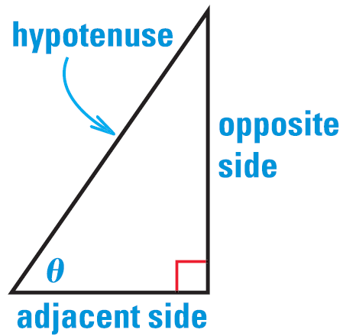
13.1 Use Trigonometry with Right Triangles
If you have a right triangle, there are six ratios of sides that are always constant
$\sin{θ}=\frac{\text{opposite}}{\text{hypotenuse}}$
$\cos{θ}=\frac{\text{adjacent}}{\text{hypotenuse}}$
$\tan{θ}=\frac{\text{opposite}}{\text{adjacent}}$
$\csc{θ}=\frac{\text{hypotenuse}}{\text{opposite}}$
$\sec{θ}=\frac{\text{hypotenuse}}{\text{adjacent}}$
$\cot{θ}=\frac{\text{adjacent}}{\text{opposite}}$
SOH
CAH
TOA

Slide 4
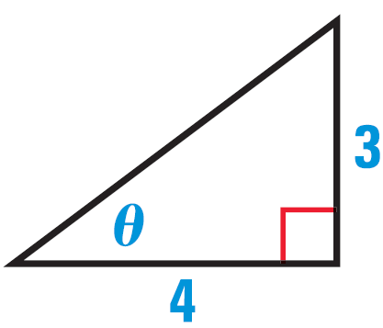
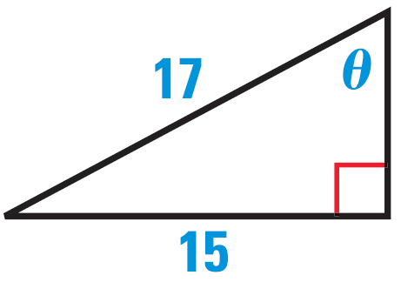
13.1 Use Trigonometry with Right Triangles
Evaluate the six trigonometric functions of the angle $θ$.
Notes:
Use Pythagorean Theorem to find hypotenuse
$$3^{2}+4^{2}=hyp^{2}$$
$$hyp=5$$
$\sin{θ}=\frac{3}{5}$ $\cos{θ}=\frac{4}{5}$ $\tan{θ}=\frac{3}{4}$
$\csc{θ}=\frac{5}{3}$ $\sec{θ}=\frac{5}{4}$ $\cot{θ}=\frac{4}{3}$
Use Pythagorean Theorem to find adjacent
$${15}^{2}+adj^{2}={17}^{2}$$
$$225+adj^{2}=289$$
$$adj^{2}=64$$
$$adj=8$$
$\sin{θ}=\frac{15}{17}$ $\cos{θ}=\frac{8}{17}$ $\tan{θ}=\frac{15}{8}$
$\csc{θ}=\frac{17}{15}$ $\sec{θ}=\frac{17}{8}$ $\cot{θ}=\frac{8}{15}$
Draw triangle and use pythagorean theorem to find opposite side
$$adj=7$$
$$hyp=10$$
$$7^{2}+{\text{opp}}^{2}={10}^{2}$$
$${opp}^{2}=51$$
$$opp=\sqrt{51}$$
$$\sin{θ}=\frac{\sqrt{51}}{10}$$

Slide 5
13.1 Use Trigonometry with Right Triangles
In a right triangle, $θ$ is an acute angle and
$\cos{θ}=\frac{7}{10}$. What is $\sin{θ}$?

Slide 6
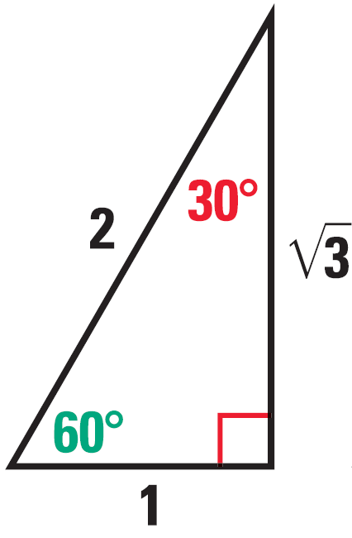
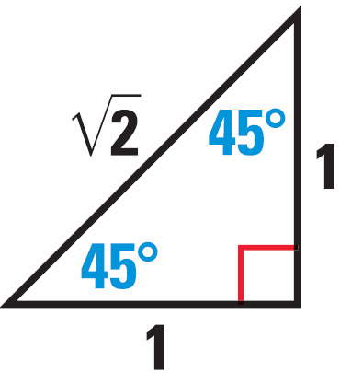
13.1 Use Trigonometry with Right Triangles
Special Right Triangles
30° - 60° - 90°
45° - 45° - 90°
Notes:
These triangles can be used to find sin, cos, tan of 30, 60, and 45 degree angles exactly.

Slide 7
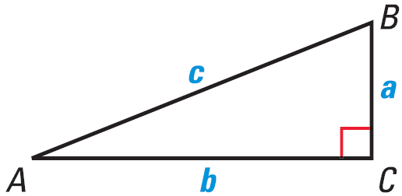
13.1 Use Trigonometry with Right Triangles
Use the diagram to solve the right triangle if…
B = 45°, c = 5
B = 60°, a = 7
A = 32°, b = 10
Notes:
A = 90° - 45° = 45°
From special rt triangle, $\sin{45°}=\frac{a}{5}=\frac{1}{\sqrt{2}}→$ $a=\frac{5}{\sqrt{2}}=\frac{5\sqrt{2}}{2}$
$\cos{45°}=\frac{b}{5}=\frac{1}{\sqrt{2}} →$ $b=\frac{5\sqrt{2}}{2}$
A = 90° - 60° = 30°
From special rt triangle; $\tan{60°=\frac{b}{7}}=\frac{\sqrt{3}}{1}→b=7\sqrt{3}$
$\cos{60°}=\frac{7}{c}=\frac{1}{2}→c=14$
B = 90° - 32° = 58°
$\tan{32°}=\frac{a}{10}→a=10\tan{32°}≈6.25$
$\cos{32°}=\frac{10}{c}→c⋅\cos{32°}=10→c=\frac{10}{\cos{32°}}≈11.79$

Slide 8
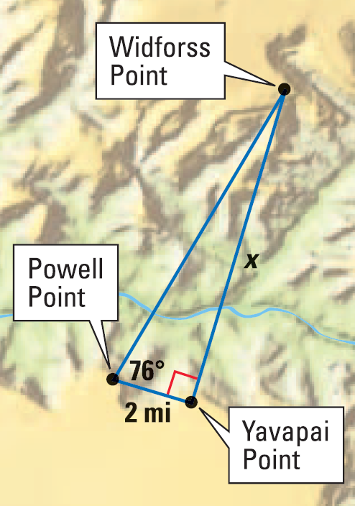
13.1 Use Trigonometry with Right Triangles
Find the distance between Powell Point and Widforss Point.
Notes:
$$\cos{76°}=\frac{2 \text{mi}}{y}$$
$$y⋅\cos{76°}=2 \text{mi}$$
$$y=\frac{2 \text{mi}}{\cos{76°}}≈8.27 \text{mi}$$

Slide 9
Quiz
13.1 Homework Quiz

Slide 10
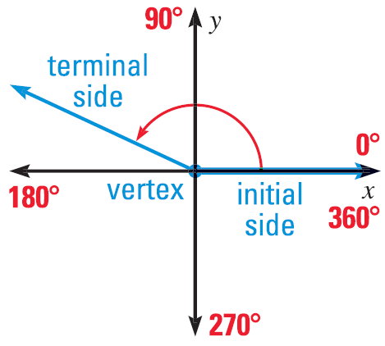
13.2 Define General Angles and Use Radian Measure
Angles in Standard Position
Vertex on origin
Initial Side on positive x-axis
Measured counterclockwise

Slide 11
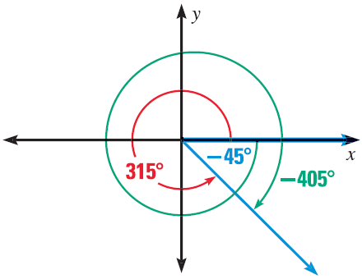
13.2 Define General Angles and Use Radian Measure
Coterminal Angles
Different angles (measures) that have the same terminal side
Found by adding or subtracting multiples of 360°

Slide 12
13.2 Define General Angles and Use Radian Measure
Draw an angle with the given measure in standard position. Then find one positive coterminal angle and one negative coterminal angle.
65°
300°
Notes:
65°+360°=425°; 65°-360°=-295°
300°+360°=660°; 300°-360°=-60°

Slide 13
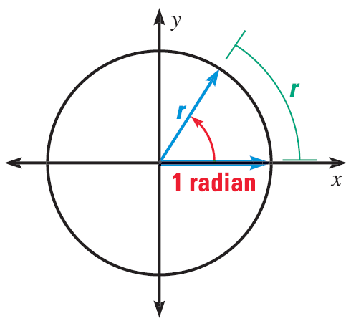
13.2 Define General Angles and Use Radian Measure
Radian measure
Another unit to measure angles
1 radian is the angle when the arc length = the radius
There are 2π radians in a circle

Slide 14
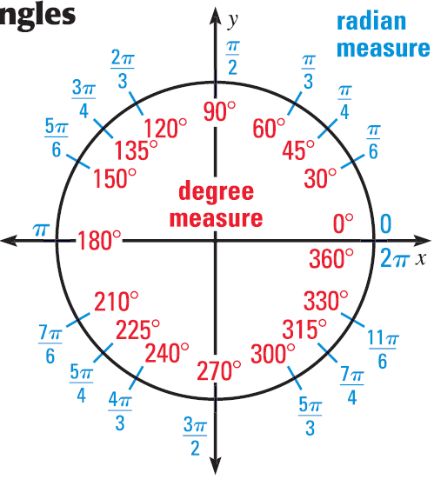
13.2 Define General Angles and Use Radian Measure
To convert between degrees and radians use fact that
180° = π
Special angles
Notes:
Probably only need to memorize 1st quadrant

Slide 15
13.2 Define General Angles and Use Radian Measure
Convert the degree measure to radians, or the radian measure to degrees.
135°
-50°
$\frac{5π}{4}$
$\frac{π}{10}$
Notes:
$$135°\left(\frac{π}{180}°\right)=\frac{3π}{4}$$
$$−50°\left(\frac{π}{180}°\right)=−\frac{5π}{18}$$
$$\frac{5π}{4}\left(\frac{180°}{π}\right)=225°$$
$$\frac{π}{10}\left(\frac{180°}{π}\right)=18°$$

Slide 16
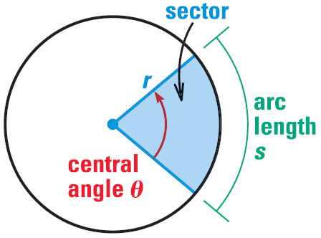
13.2 Define General Angles and Use Radian Measure
Sector
Slice of a circle
Arc Length
$s=rθ$
$θ$ must be in radians!
Area of Sector
$A=\frac{1}{2}r^{2}θ$
$θ$ must be in radians!

Slide 17
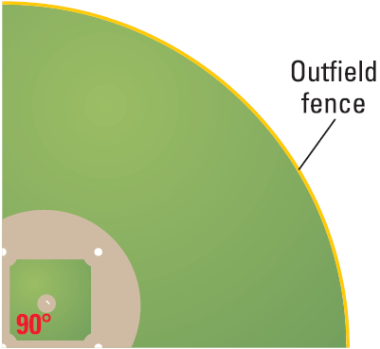
13.2 Define General Angles and Use Radian Measure
Find the length of the outfield fence if it is 220 ft from home plate.
Find the area of the baseball field.
Notes:
$$θ=\frac{π}{2}$$
$$s=rθ$$
$$s=220\left(\frac{π}{2}\right)=110π≈346$$
$$A=\frac{1}{2}r^{2}θ$$
$$A=\frac{1}{2}{\left(220\right)}^{2}\left(\frac{π}{2}\right)=12100π≈38013$$

Slide 18
Quiz
13.2 Homework Quiz

Slide 19
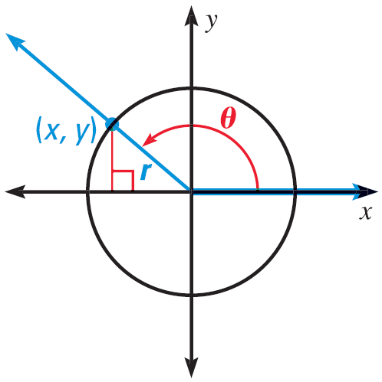
13.3 Evaluate Trigonometric Functions of Any Angle
Think of a point on the terminal side of an angle
You can draw a right triangle with the x-axis
$\sin{θ}=\frac{y}{r}$ $\csc{θ}=\frac{r}{y}$
$\cos{θ}=\frac{x}{r}$ $\sec{θ}=\frac{r}{x}$
$\tan{θ}=\frac{y}{x}$ $\cot{θ}=\frac{x}{y}$
Unit Circle
r = 1

Slide 20
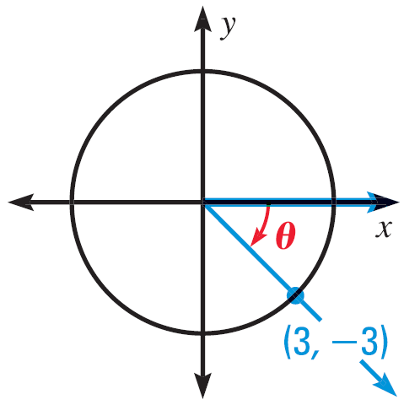
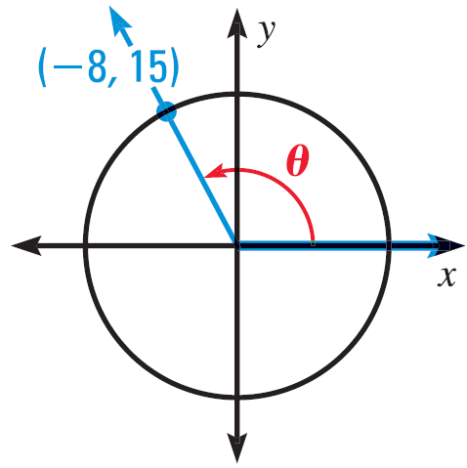
13.3 Evaluate Trigonometric Functions of Any Angle
Evaluate the six trigonometric functions of θ.
Notes:
$$r^{2}=x^{2}+y^{2}=3^{2}+{\left(−3\right)}^{2}$$
$$r=\sqrt{18}=3\sqrt{2}$$
$\sin{θ}=−\frac{3}{3\sqrt{2}}=−\frac{\sqrt{2}}{2} \cos{θ}=\frac{3}{3\sqrt{2}}=\frac{\sqrt{2}}{2}$ $\tan{θ}=−\frac{3}{3}=−1$
$\csc{θ}=−\sqrt{2}$ $\sec{θ}=\sqrt{2}$ $\cot{θ}=−1$
$$r^{2}={\left(−8\right)}^{2}+{15}^{2}=289$$
$$r=17$$
$\sin{θ}=\frac{15}{17}$ $\cos{θ}=−\frac{8}{17}$ $\tan{θ}=−\frac{15}{8}$
$\csc{θ}=\frac{17}{15}$ $\sec{θ}=−\frac{17}{8}$ $\cot{θ}=−\frac{8}{15}$
$\sin{θ}=0$ $\cos{θ}=−1$ $\tan{θ}=0$
$\csc{θ}=und$ $\sec{θ}=−1$ $\cot{θ}=und$

Slide 21
13.3 Evaluate Trigonometric Functions of Any Angle
Evaluate the six trigonometric functions of θ.
θ = 180°
Notes:
$$r^{2}=x^{2}+y^{2}=3^{2}+{\left(−3\right)}^{2}$$
$$r=\sqrt{18}=3\sqrt{2}$$
$\sin{θ}=−\frac{3}{3\sqrt{2}}=−\frac{\sqrt{2}}{2} \cos{θ}=\frac{3}{3\sqrt{2}}=\frac{\sqrt{2}}{2}$ $\tan{θ}=−\frac{3}{3}=−1$
$\csc{θ}=−\sqrt{2}$ $\sec{θ}=\sqrt{2}$ $\cot{θ}=−1$
$$r^{2}={\left(−8\right)}^{2}+{15}^{2}=289$$
$$r=17$$
$\sin{θ}=\frac{15}{17}$ $\cos{θ}=−\frac{8}{17}$ $\tan{θ}=−\frac{15}{8}$
$\csc{θ}=\frac{17}{15}$ $\sec{θ}=−\frac{17}{8}$ $\cot{θ}=−\frac{8}{15}$
$\sin{θ}=0$ $\cos{θ}=−1$ $\tan{θ}=0$
$\csc{θ}=und$ $\sec{θ}=−1$ $\cot{θ}=und$

Slide 22
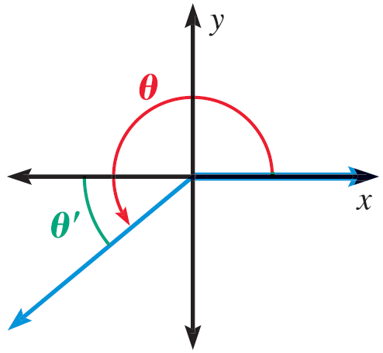
13.3 Evaluate Trigonometric Functions of Any Angle
Reference Angle
Angle between terminal side and x-axis
Has the same values for trig functions as 1st quadrant angles
You just have to add the negative signs
Sin
All
Tan
Cos
Notes:
This gives what is positive.
The reciprocal functions are the same (csc is with sin, etc.)
Way to remember “All Students Take Calculus”

Slide 23
13.3 Evaluate Trigonometric Functions of Any Angle
Sketch the angle. Then find its reference angle.
150°
$−\frac{7π}{9}$
Evaluate cos(-60°) without a calculator
Notes:
$$180°−150°=30°$$
$$π−\frac{7π}{9}=\frac{2π}{9}$$
Reference angle is 60°
In quadrant IV
$$\cos\left(−60°\right)=\frac{1}{2}$$

Slide 24
13.3 Evaluate Trigonometric Functions of Any Angle
Estimate the horizontal distance traveled by a Red Kangaroo who jumps at an angle of 8° and with an initial speed of 53 feet per second (35 mph).
Notes:
$$d=\frac{v^{2}}{32}\sin{2θ}$$
$$d=\frac{{53}^{2}}{32}\sin\left(2\left(8°\right)\right)=24.2 ft$$

Slide 25
Quiz
13.3 Homework Quiz

Slide 26
13.4 Evaluate Inverse Trigonometric Functions
Find an angle whose tangent = 1
There are many
$\frac{π}{4},\frac{5π}{4}, −\frac{3π}{4},$etc.
In order to find angles given sides (or x and y) we have to define the functions carefully

Slide 27
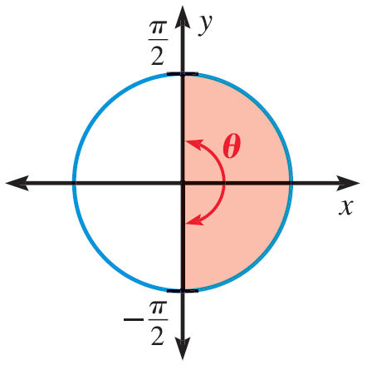
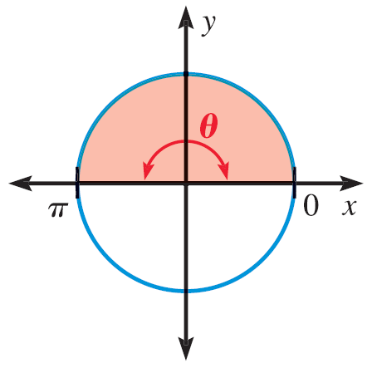
13.4 Evaluate Inverse Trigonometric Functions
$$\sin^{−1}{a}$$
Inverse Trig Functions
$\sin^{−1}{a}=θ$
$−\frac{π}{2}≤θ≤\frac{π}{2}$
$\cos^{−1}{a}=θ$
$0≤θ≤π$
$\tan^{−1}{a}=θ$
$−\frac{π}{2}<θ<\frac{π}{2}$
$$\cos^{−1}{a}$$
$$\tan^{−1}{a}$$

Slide 28
13.4 Evaluate Inverse Trigonometric Functions
Evaluate the expression in both radians and degrees.
$\sin^{−1}{\frac{\sqrt{2}}{2}}$
$\cos^{−1}{\frac{1}{2}}$
$\tan^{−1}{−1}$
Notes:
$$\sin^{−1}{\frac{\sqrt{2}}{2}}=45° \text{or} \frac{π}{4}$$
$$\cos^{−1}{\frac{1}{2}}=60° \text{or}\frac{π}{3}$$
$$\tan^{−1}{−1}=−45° \text{or} −\frac{π}{4}$$

Slide 29
13.4 Evaluate Inverse Trigonometric Functions
Solve the equation for θ
$\cos{θ}=0.4;270°<θ<360°$
$\tan{θ}=4.7;180°<θ<270°$
$\sin{θ}=0.62;90°<θ<180°$
Notes:
$$\cos{θ}=0.4$$
$$θ=\cos^{−1}{0.4}=66.4°$$
Quadrant IV with reference angle 66.4°
$$θ=360°−66.4°=293.6°$$
$$\tan{θ}=4.7$$
$$θ=\tan^{−1}{4.7}=78.0°$$
Quadrant III with reference angle 78.0°
$$180°+78.0°=258°$$
$$\sin{θ}=0.62$$
$$θ=\sin^{−1}{0.62}=38.3°$$
Quadrant II with reference angle 38.3°
$$180°−38.3°=141.7°$$

Slide 30
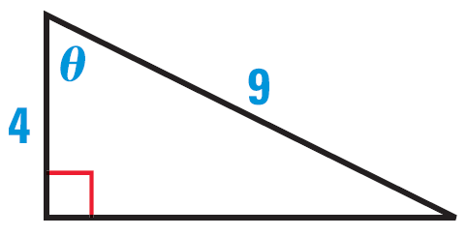
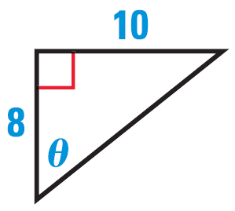
13.4 Evaluate Inverse Trigonometric Functions
Find the measure of angle θ.
Notes:
$$\cos{θ}=\frac{4}{9}$$
$$θ=\cos^{−1}{\frac{4}{9}}=63.6°$$
$$\tan{θ}=\frac{10}{8}$$
$$θ=\tan^{−1}{\frac{10}{8}}=51.3°$$

Slide 31
Quiz
13.4 Homework Quiz

Slide 32
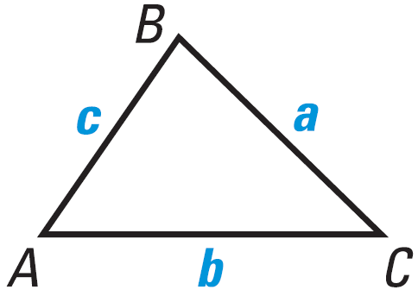
13.5 Apply the Law of Sines
In lesson 13.1 we solved right triangles
In this lesson we will solve any triangle if we know
2 Angles and 1 Side (AAS or ASA)
2 Sides and 1 Angle opposite a side (SSA)
Law of Sines
$\frac{\sin{A}}{a}=\frac{\sin{B}}{b}=\frac{\sin{C}}{c}$

Slide 33
13.5 Apply the Law of Sines
Solve ΔABC if…
A = 51°, B = 44°, c = 11
Notes:
$$C=180°−51°−44°=85°$$
$$\frac{\sin{C}}{c}=\frac{\sin{A}}{a}$$
$$\frac{\sin{85°}}{11}=\frac{\sin{51°}}{a}$$
$$a⋅\sin{85°}=11⋅\sin{51°}$$
$$a=\frac{11⋅\sin{51°}}{\sin{85°}}≈8.58$$
$$\frac{\sin{C}}{c}=\frac{\sin{B}}{b}$$
$$\frac{\sin{85°}}{11}=\frac{\sin{44°}}{b}$$
$$b⋅\sin{85°}=11⋅\sin{44°}$$
$$b=\frac{11⋅\sin{44°}}{\sin{85°}}≈7.67$$

Slide 34
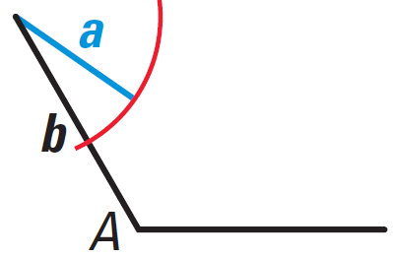
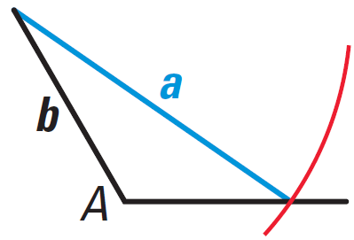
13.5 Apply the Law of Sines
Indeterminant Case (SSA)
Maybe no triangle, one triangle, or two triangles
In these examples, you know a, b, A
If A > 90° and…
a ≤ b → no triangle
a > b → 1 triangle

Slide 35
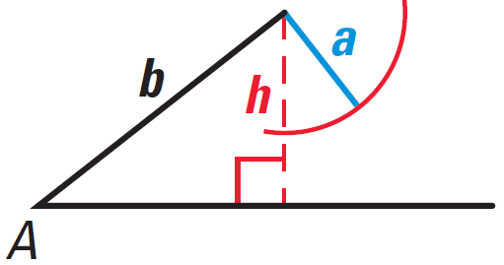
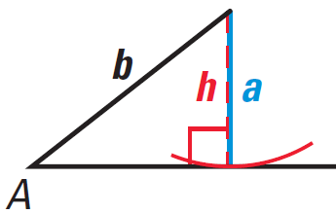
13.5 Apply the Law of Sines
A < 90° and… (h = b sin A)
h > a → no triangle
h = a → one triangle

Slide 36
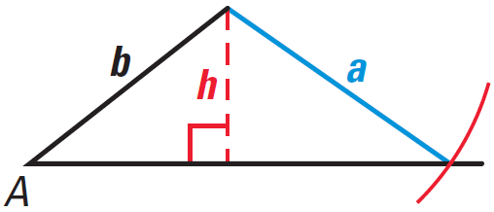
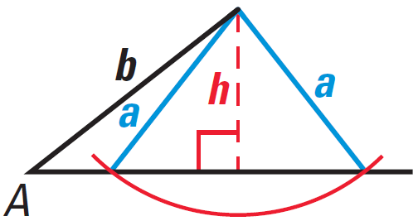
13.5 Apply the Law of Sines
a ≥ b → one triangle
h < a < b → two triangles

Slide 37
13.5 Apply the Law of Sines
Solve ΔABC
A = 122°, a = 18, b = 12
A = 36°, a = 9, b = 12
Notes:
a > b → one triangle
$$\frac{\sin{A}}{a}=\frac{\sin{B}}{b}$$
$$\frac{\sin{122°}}{18}=\frac{\sin{B}}{12}$$
$$18\sin{B}=12\sin{122°}$$
$$\sin{B}=\frac{12\sin{122°}}{18}≈0.5654$$
$$B=\sin^{−1}{0.5654}≈34.4°$$
$$C=180°−34.4°−122°=23.6°$$
$$\frac{\sin{A}}{a}=\frac{\sin{C}}{c}$$
$$\frac{\sin{122°}}{18}=\frac{\sin{23.6°}}{c}$$
$$c⋅\sin{122°}=18\sin{23.6°}$$
$$c=\frac{18\sin{23.6°}}{\sin{122°}}≈8.50$$
h = b sin A = 12 sin 36° = 7.05; h < a < b → two solutions
$$\frac{\sin{A}}{a}=\frac{\sin{B}}{b}$$
$$\frac{\sin{36°}}{9}=\frac{\sin{B}}{12}$$
$$9\sin{B}=12\sin{36°}$$
$$\sin{B}=\frac{12\sin{36°}}{9}≈0.7837$$
$$B=\sin^{−1}{0.7837}≈51.6°$$
To angles for B and they are supplementary
$B=51.6°$ $B^{′}=180°−51.6°=128.4°$
$C=180°−51.6°−36°=92.4°$ $C^{′}=180°−128.4°−36°=15.6°$
$$\frac{\sin{A}}{a}=\frac{\sin{C}}{c}$$
$\frac{\sin{36°}}{9}=\frac{\sin{92.4°}}{c}$ $\frac{\sin{36°}}{9}=\frac{\sin{15.6°}}{c}$
$c\sin{36°}=9\sin{92.4°}$ $c\sin{36°}=9\sin{15.6°}$
$c=\frac{9\sin{92.4°}}{\sin{36°}}≈15.3$ $c=\frac{9\sin{15.6°}}{\sin{36°}}≈4.1$

Slide 38
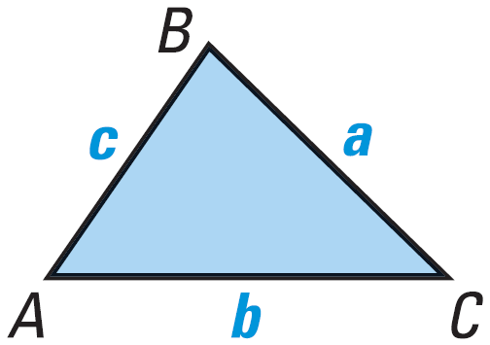
13.5 Apply the Law of Sines
Area of Triangle
$Area=\frac{1}{2}bh$
$h=c\sin{A}$
$Area=\frac{1}{2}bc\sin{A}$
Find the area of ΔABC with…
a = 10, b = 14, C = 46°
Notes:
$$Area=\frac{1}{2}ab\sin{C}$$
$$Area=\frac{1}{2}\left(10\right)\left(14\right)\sin{46°}≈50.4$$

Slide 39
Quiz
13.5 Homework Quiz

Slide 40
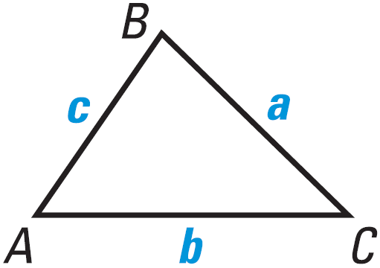
13.6 Apply the Law of Cosines
When you need to solve a triangle and can’t use Law of Sines, use Law of Cosines
2 Sides and Included angle (SAS)
3 Sides (SSS)
Law of Cosines
$a^{2}=b^{2}+c^{2}−2bc\cos{A}$
$b^{2}=a^{2}+c^{2}−2ac\cos{B}$
$c^{2}=a^{2}+b^{2}−2ab\cos{C}$
Notes:
You can use the Law of Cosines, then Law of Sines as long as you don’t create the SSA case.

Slide 41
13.6 Apply the Law of Cosines
Solve ΔABC if…
a = 8, c = 10, B = 48°
a = 14, b = 16, c = 9
Notes:
$$b^{2}=a^{2}+c^{2}−2ac\cos{B}$$
$$b^{2}=8^{2}+{10}^{2}−2\left(8\right)\left(10\right)\cos{48°}=56.94$$
$$b=7.55$$
$$a^{2}=b^{2}+c^{2}−2ab\cos{A}$$
$$8^{2}={7.55}^{2}+{10}^{2}−2⋅7.55⋅10\cos{A}$$
$$64=57.00+100−151\cos{A}$$
$$−93=−151\cos{A}$$
$$0.61589404=\cos{A}$$
$$A=\cos^{−1}{0.61589404}≈52.0°$$
$$C=180°−48°−52.0°=80°$$
$$a^{2}=b^{2}+c^{2}−2bc\cos{A}$$
$${14}^{2}={16}^{2}+9^{2}−2\left(16\right)\left(9\right)\cos{A}$$
$$196=256+81−288\cos{A}$$
$$−141=−288\cos{A}$$
$$0.4896=\cos{A}$$
$$A=\cos^{−1}{0.4896}≈60.7°$$
$$b^{2}=a^{2}+c^{2}−2ac\cos{B}$$
$${16}^{2}={14}^{2}+9^{2}−2⋅14⋅9\cos{B}$$
$$256=196+81−252\cos{B}$$
$$−21=−252\cos{B}$$
$$0.08333333333=\cos{B}$$
$$B=\cos^{1}{0.0833333}≈85.2°$$
$$C=180°−60.7°−85.2°=34.1°$$

Slide 42
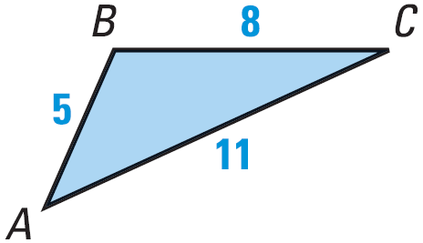
13.6 Apply the Law of Cosines
Heron’s Area Formula
$Area=\sqrt{s\left(s−a\right)\left(s−b\right)\left(s−c\right)}$
Where $s=\frac{1}{2}\left(a+b+c\right)$
Find the area of ΔABC
Notes:
$$s=\frac{1}{2}\left(a+b+c\right)$$
$$s=\frac{1}{2}\left(8+11+5\right)=12$$
$$Area=\sqrt{s\left(s−a\right)\left(s−b\right)\left(s−c\right)}$$
$$Area=\sqrt{12\left(12−8\right)\left(12−11\right)\left(12−5\right)}=\sqrt{336}=18.3$$

Slide 43
Quiz
13.6 Homework Quiz

